Slide 1


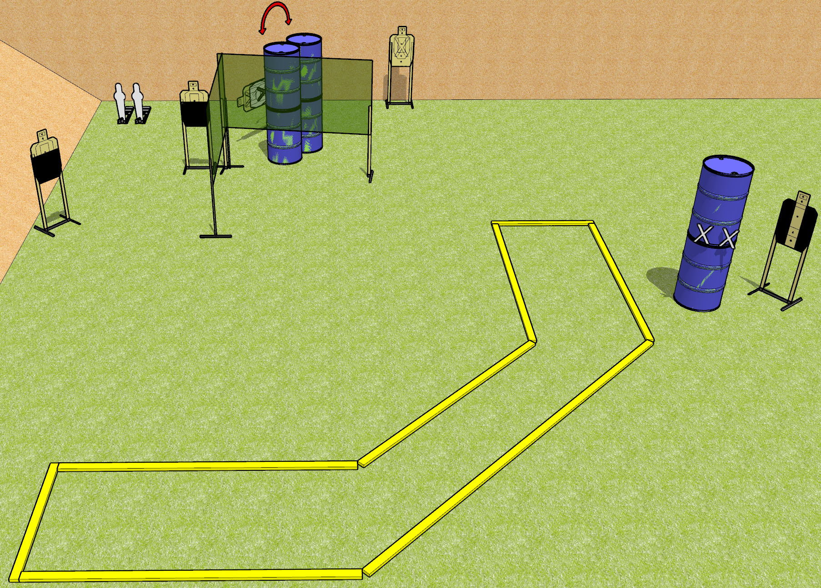
 | Dothan Gun Club – USPSA Match Painfully Partial Course Designer : Drew Coleman
START POSITION : Standing with both hands touching marks on barrel. PCC muzzle touching right hand mark.
GUN READY CONDITION : Pistol loaded and holstered. PCC loaded, shouldered, safety on, muzzle touching right hand mark. |  | SCORING: Comstock, 12 rounds TARGETS: 5 paper, 2 Steel SCORED HITS: Best 2 on paper, steel until down START-STOP: Audible, last shot RULES:
STAGE PROCEDURE: Engage targets as they become available from within the fault lines.

Slide 2
Painfully Partial
Written Stage Briefing
Painfully Partial is a 12 round, 60 point, Comstock Short Course. There are five USPSA targets and two mini poppers. The best two hits on paper will score and steel must fall to score. The start signal is audible.
Handgun start position is standing outside the shooting area with both hands touching marks on barrel. Handgun is loaded and holstered.
PCC start position is standing outside the shooting area with muzzle touching the right hand mark. Loaded carbine is held with both hands, shouldered, safety on.
Upon start signal, engage the targets as they become available from within the shooting area. Either mini popper will activate the swinging target.

